Slide 1
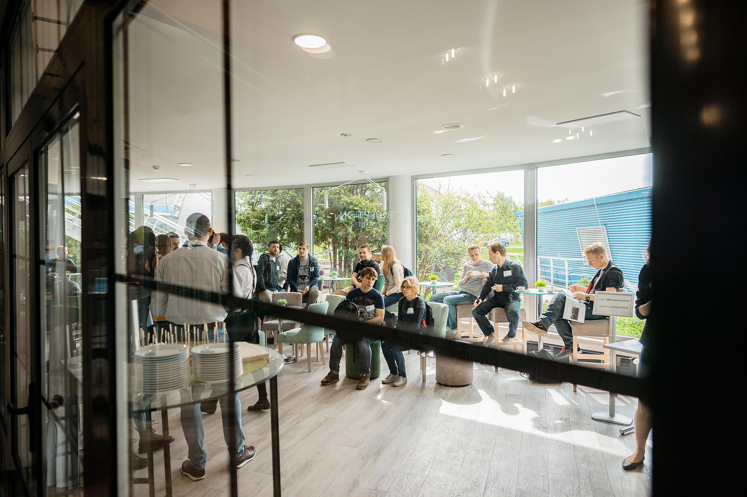


IoT Foundations - Kickstart Your Journey with AWS

Slide 2


Introduction;
IoT - Big Picture;
Examples of IoT Applications;
Device and Cloud Communication;
Coffee Break
AWS IoT Core DEMOs;
AWS IoT Services Landscape and Future Plans;
Q&A / Networking.
AGENDA
Notes:
Slide for PM/Developer/QA

Slide 3



Mikhail Vataleu is
a Solution Architect in the Internet of Things (IoT) field with core expertise in Amazon Web Services (AWS). The Head of Solution Architecture Competency at Klika Tech, Inc.

Slide 4

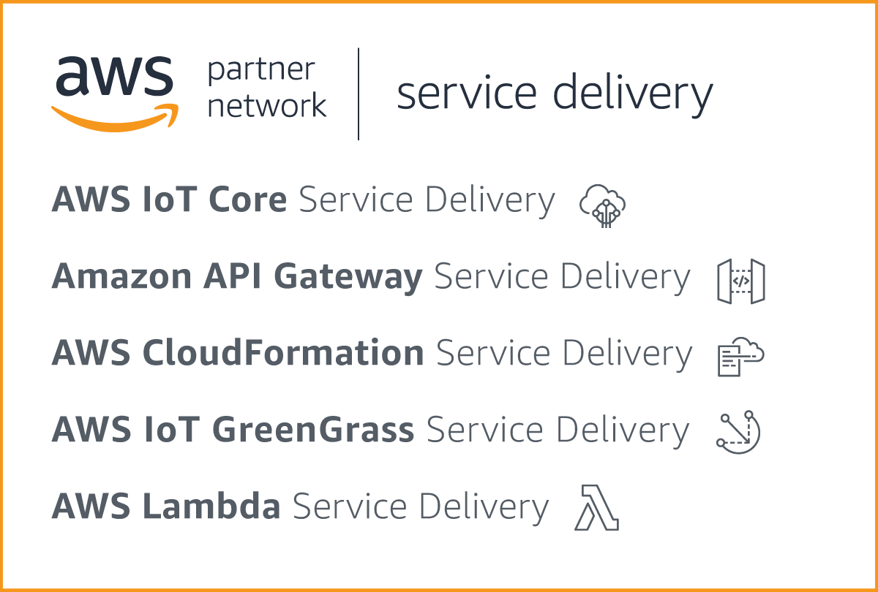

Klika Tech is
a global IoT, Cloud-native and Big Data product and solutions development company headquartered in the U.S., with offices in North America, Europe and Asia.

Slide 5
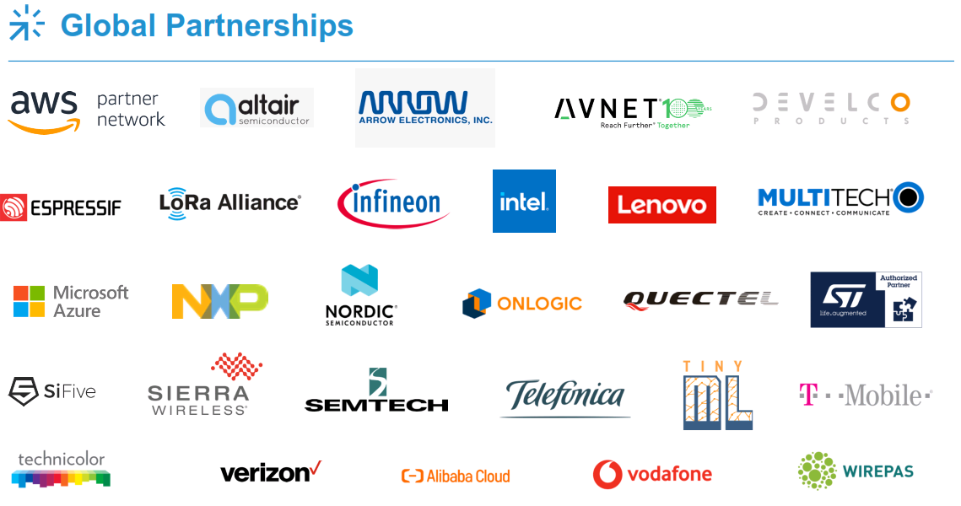

Slide 6

Big Picture of Internet of Things
SECTION #1

Slide 7
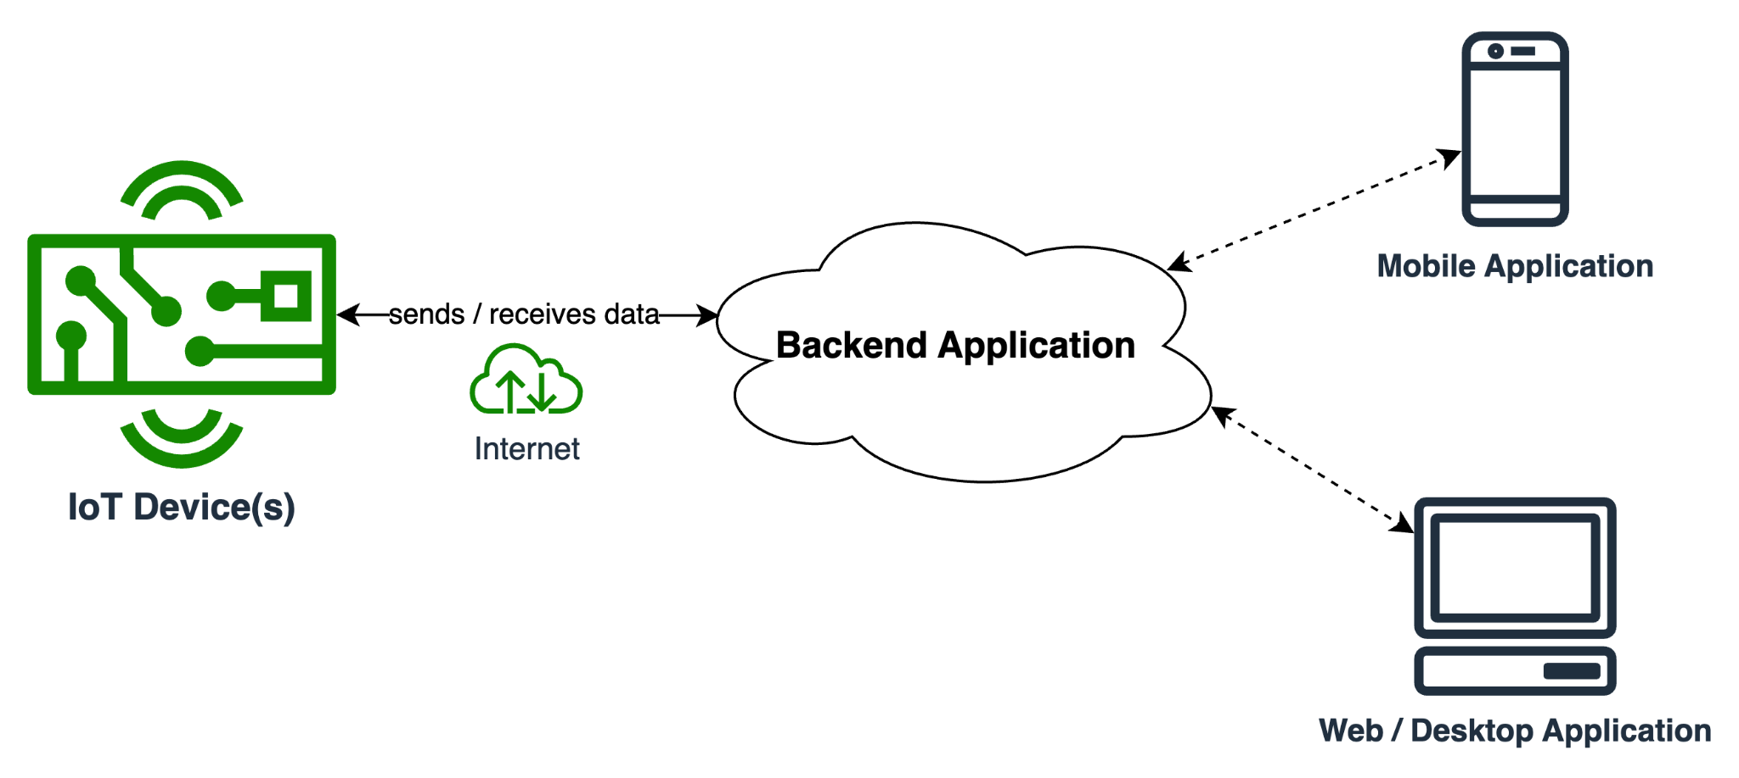
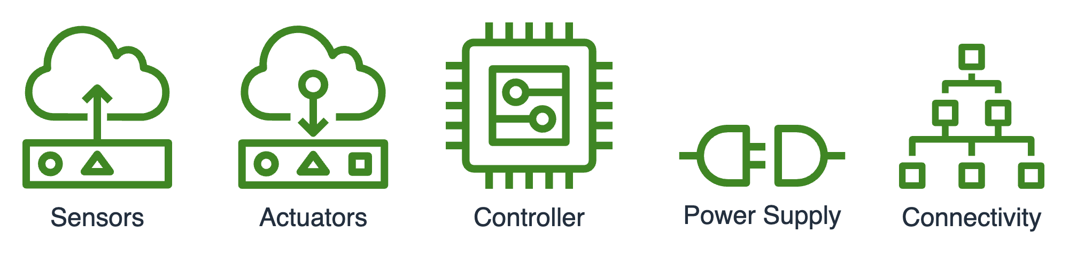
Simple IoT Application

Slide 8
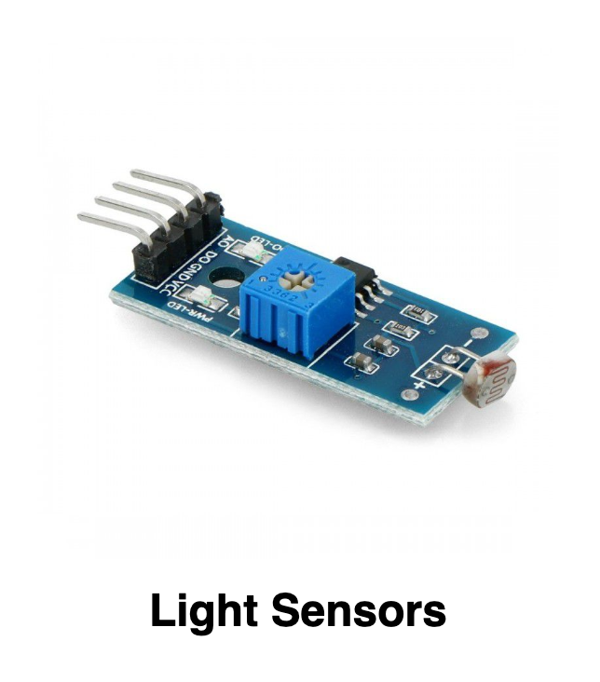
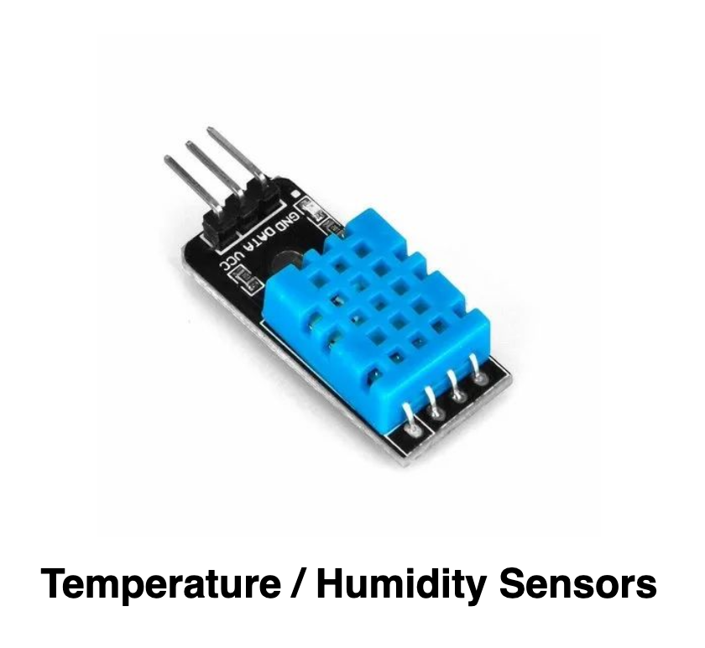
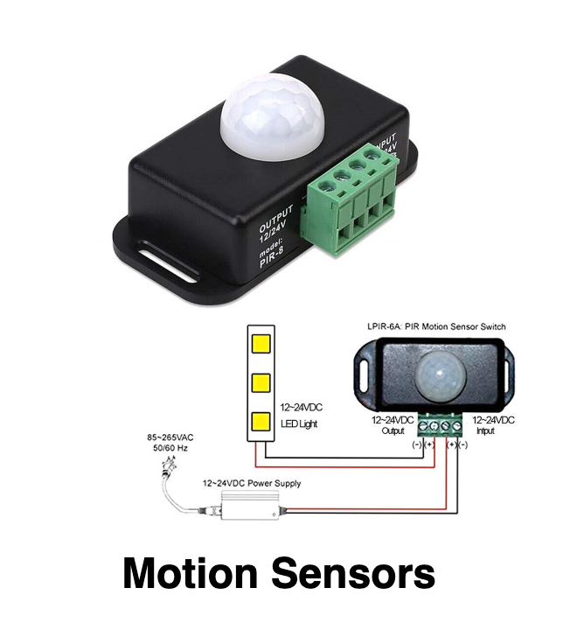
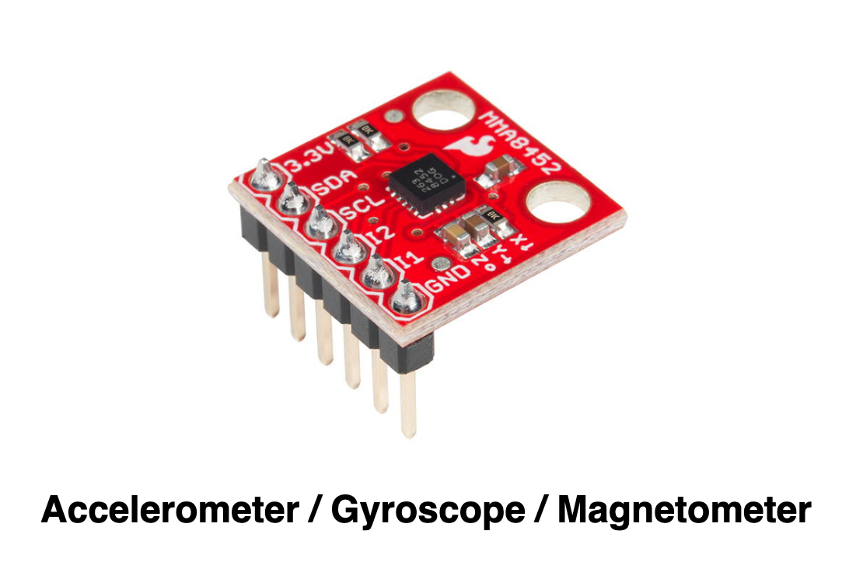
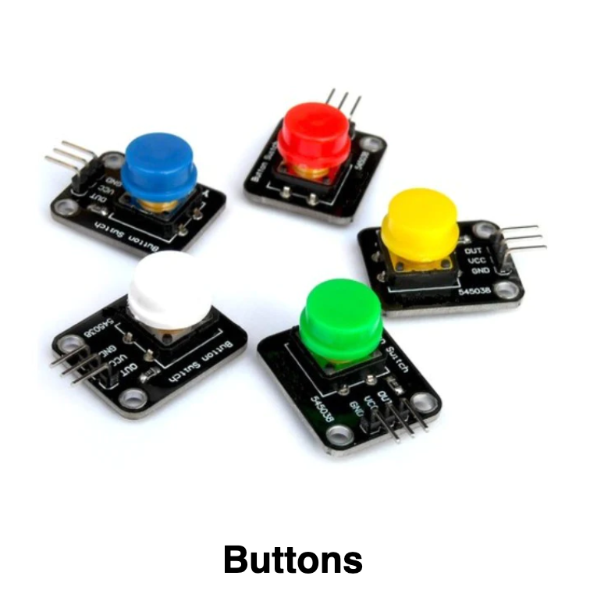
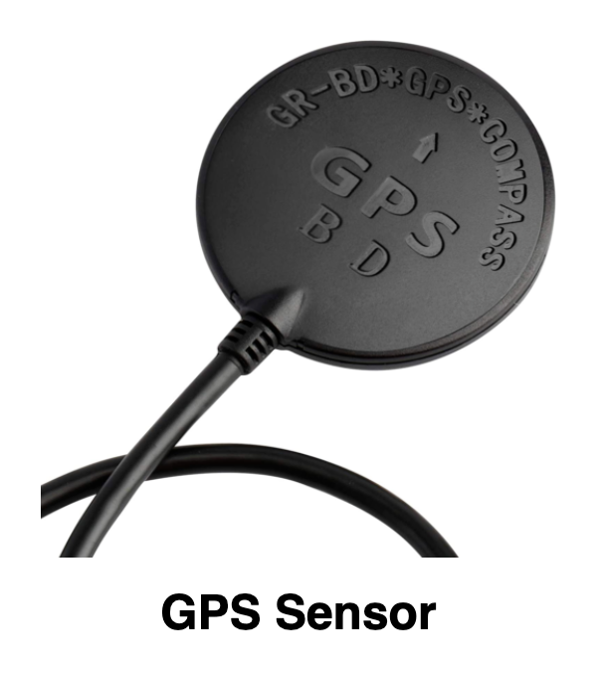

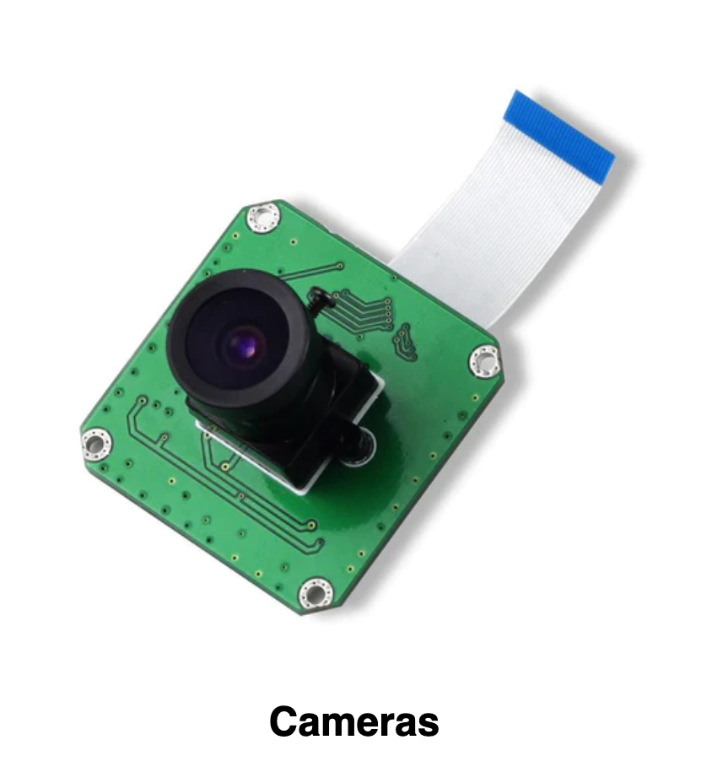
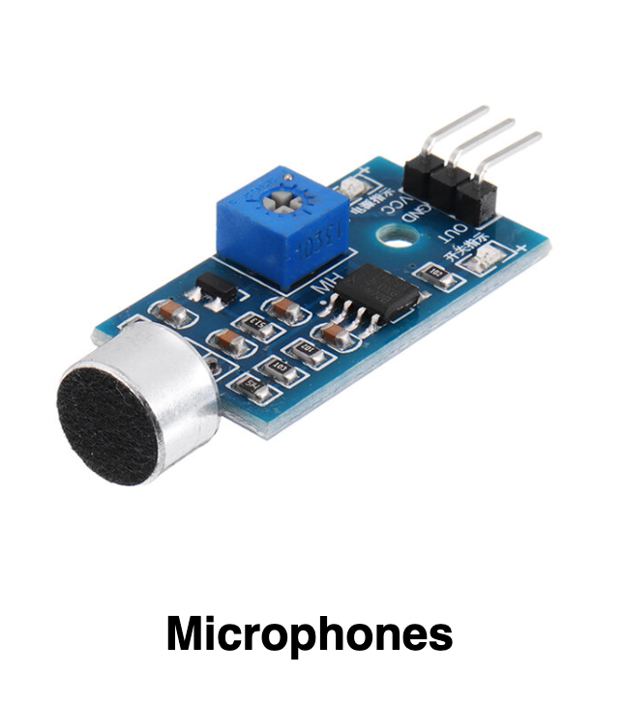
Sensor is
a device that detects and measures physical phenomena
And Many Many others…

Slide 9
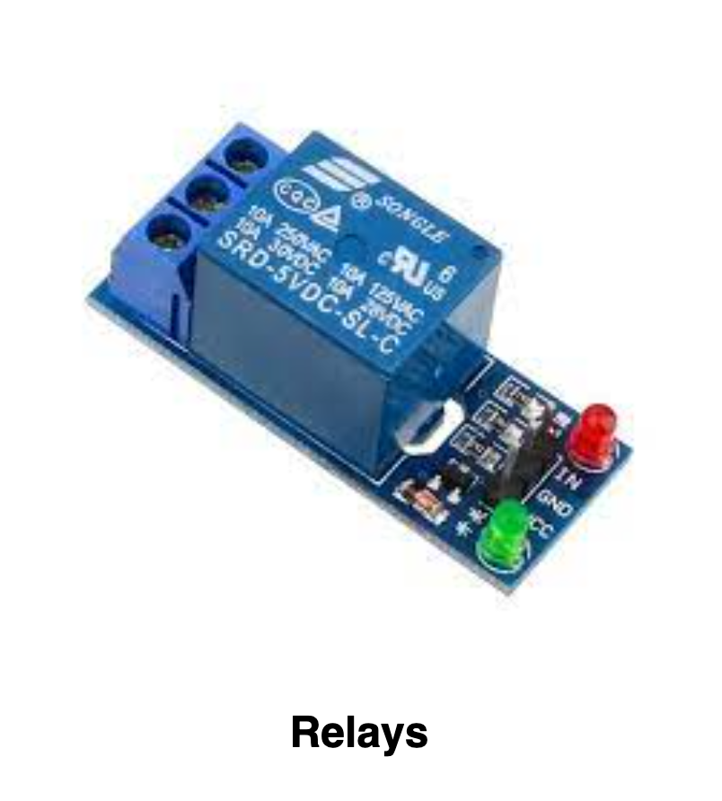
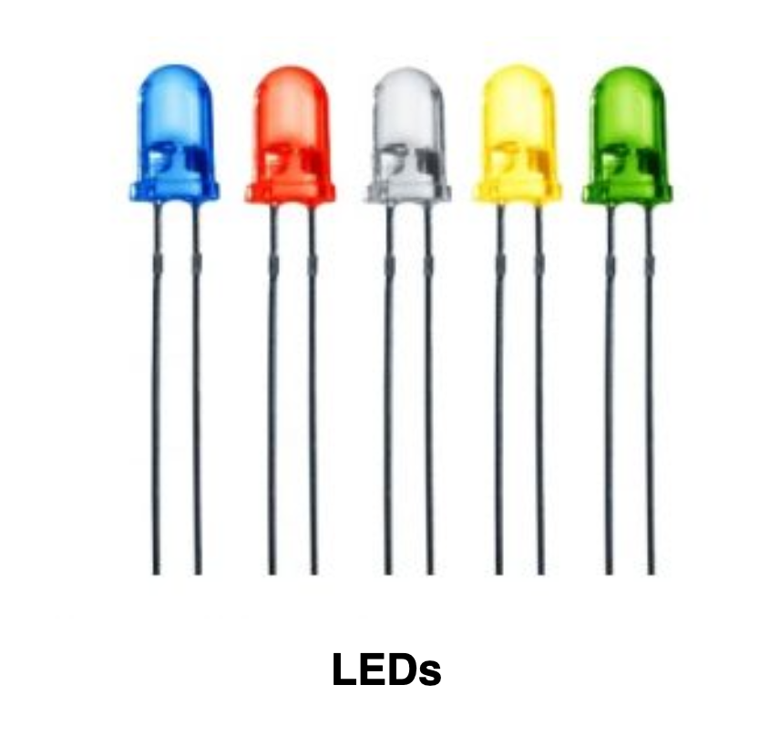
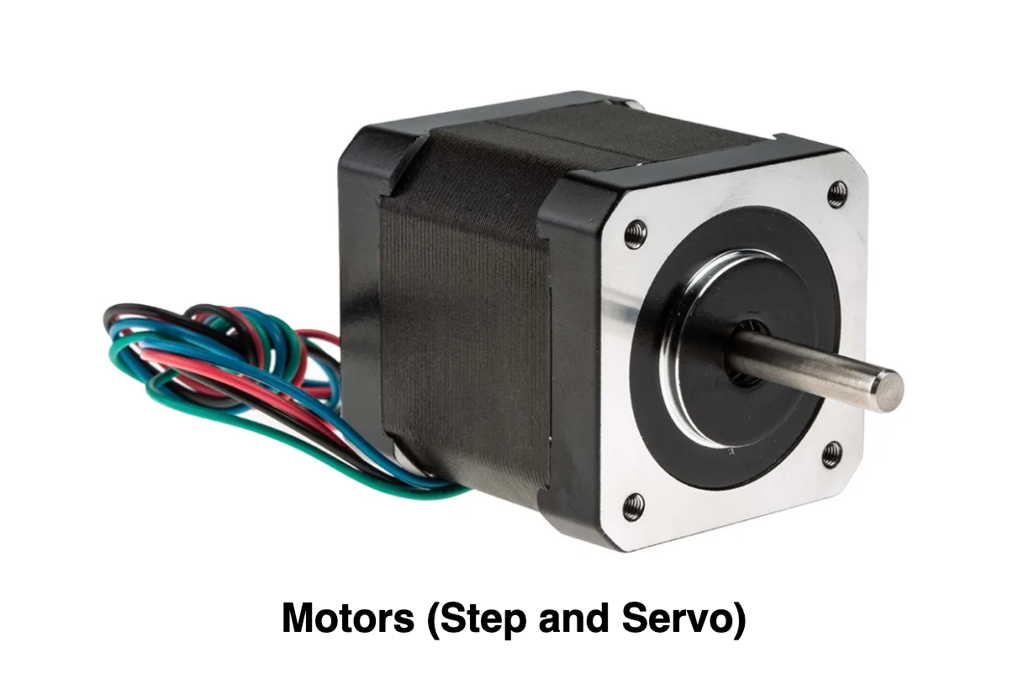
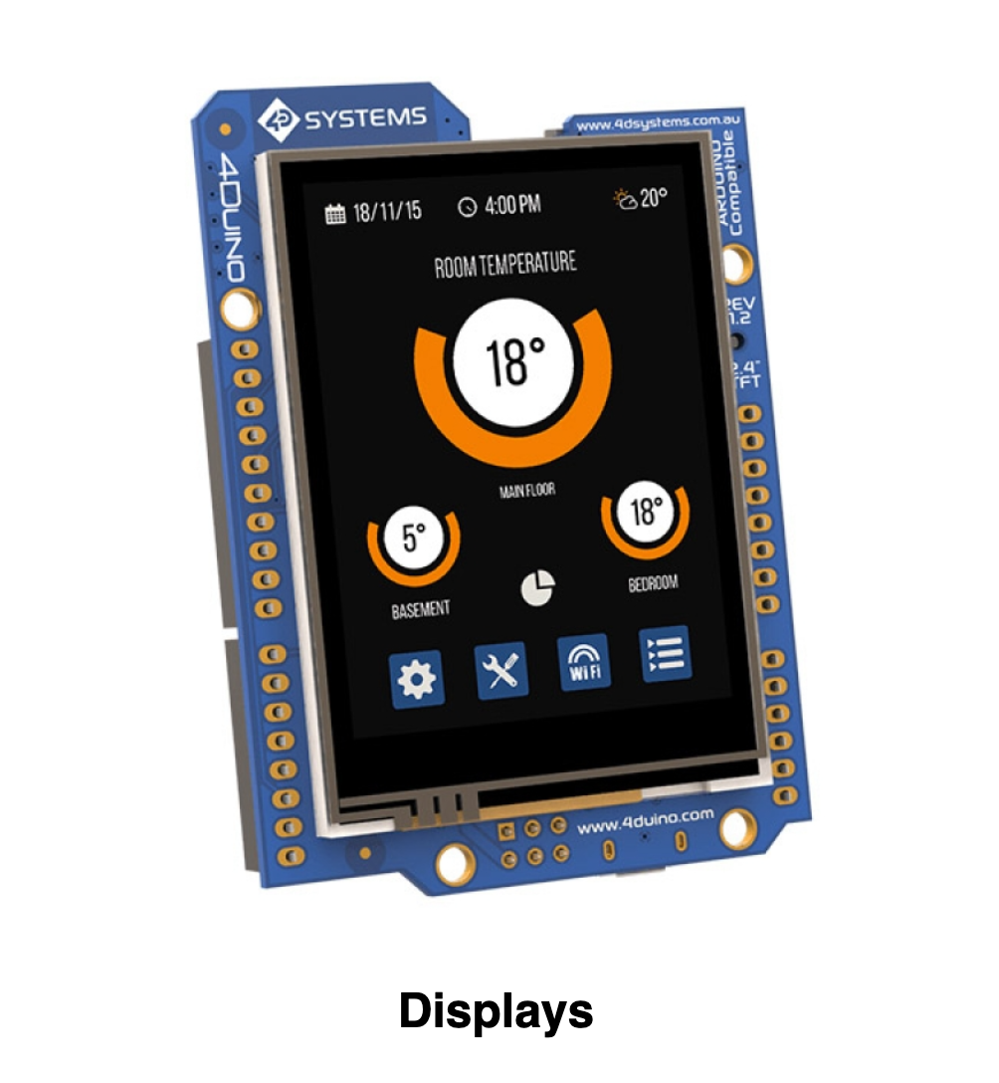
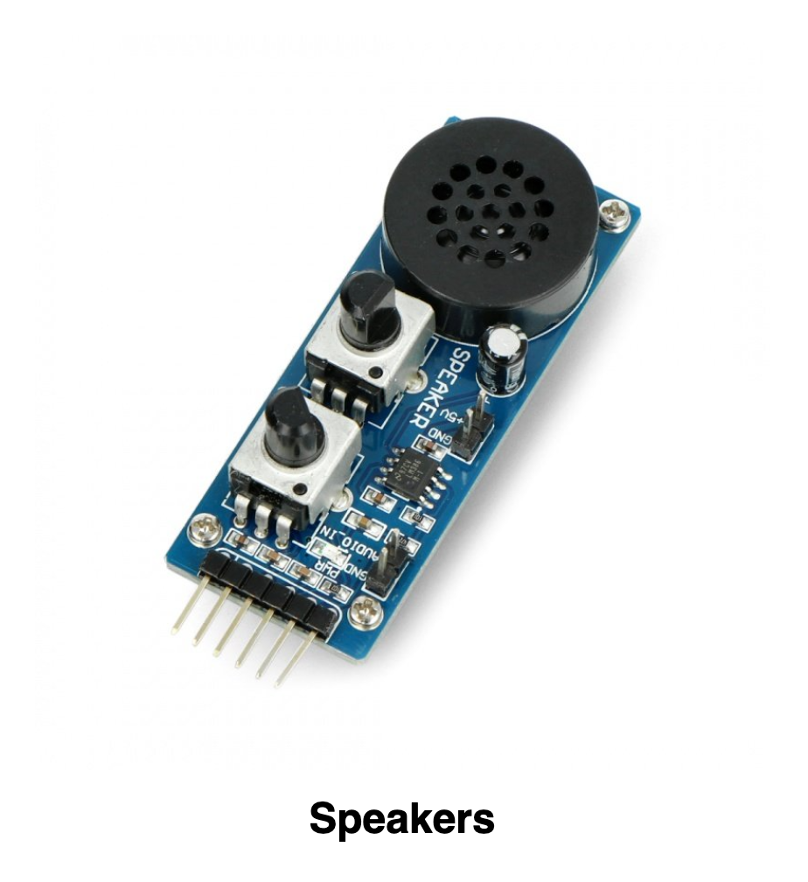
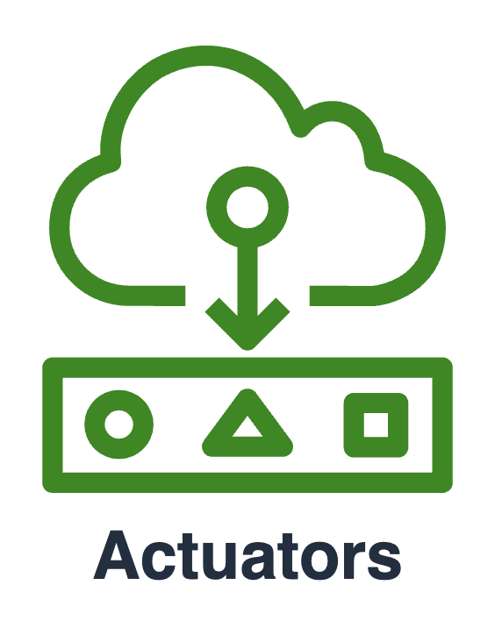
Actuator is
a device that converts digital signals into physical actions
And Many Many others…

Slide 10
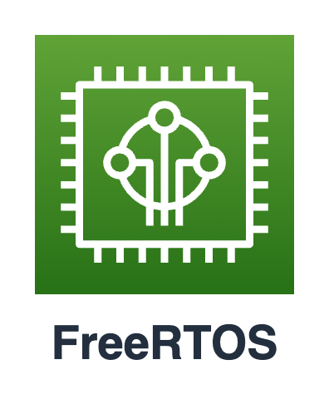


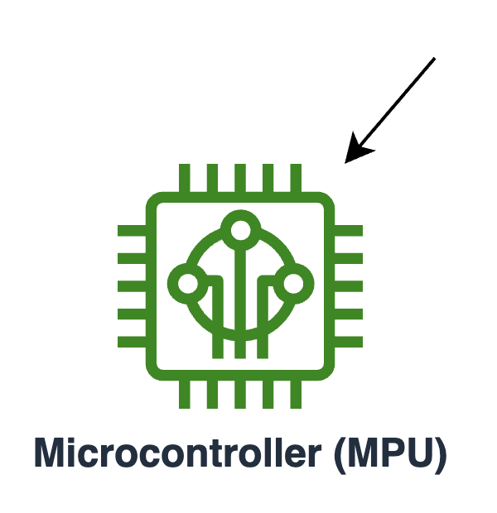
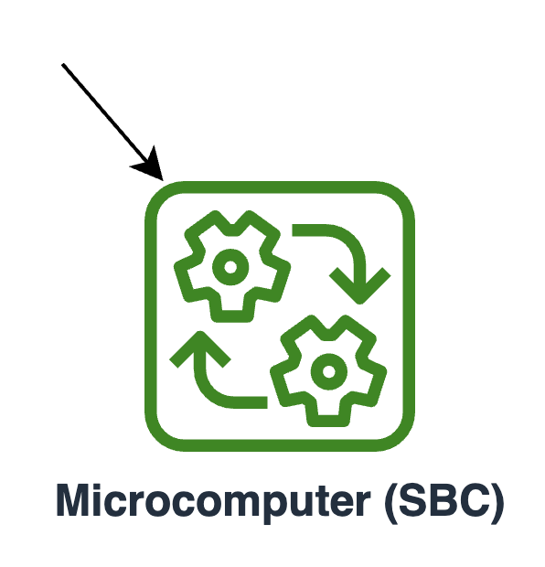
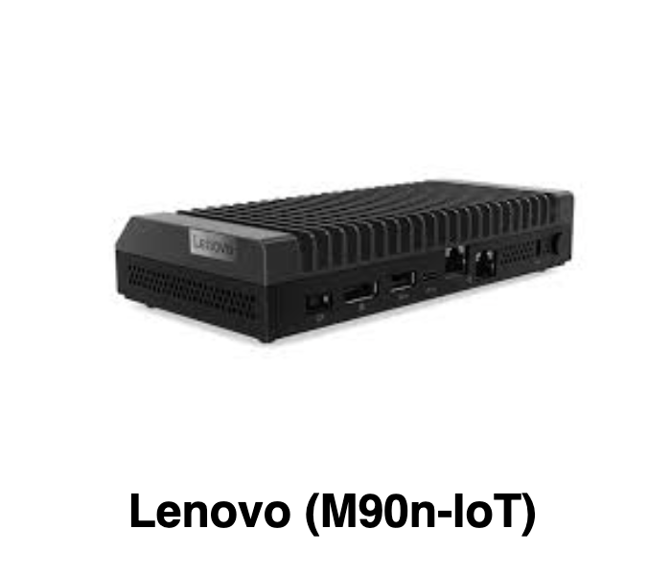
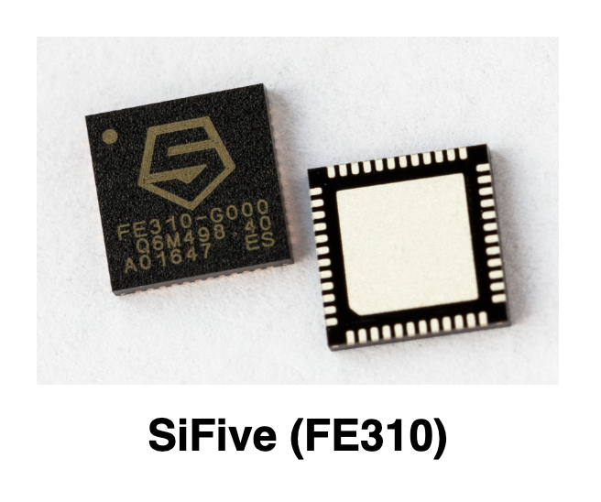
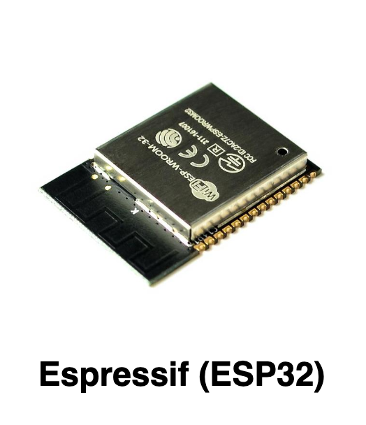
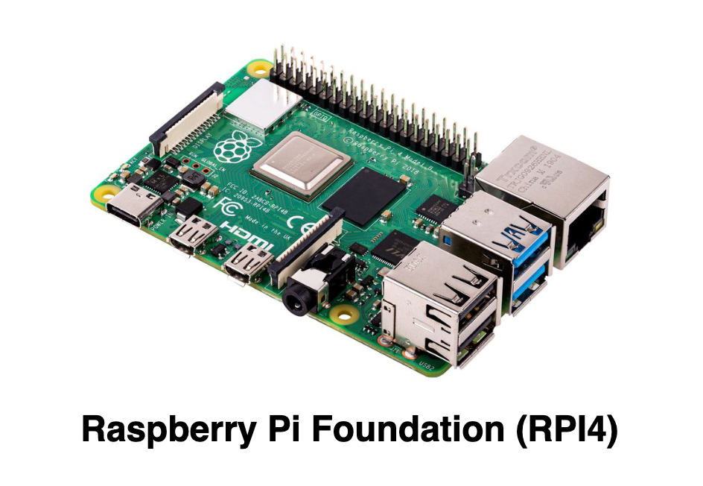
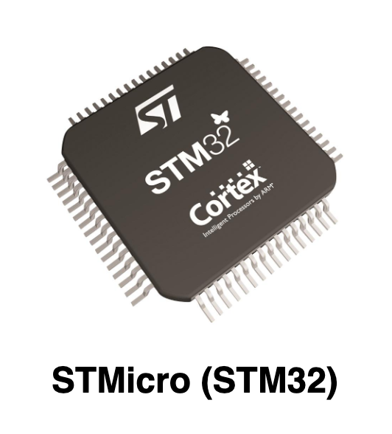
Controllers
Notes:
Microcontrollers:
designed to govern a specific operation
Low-end (Kb of RAM and Flash, Mhz for cores
The cheapest tier
bare-metal firmware development
Microcomputers:
Capable to run OS like Linux, Windows, etc
High-end (GB of RAM and Storage, GHz for multicore CPU)
High costs
Applications can build using high-level programming languages (Python, etc)

Slide 11

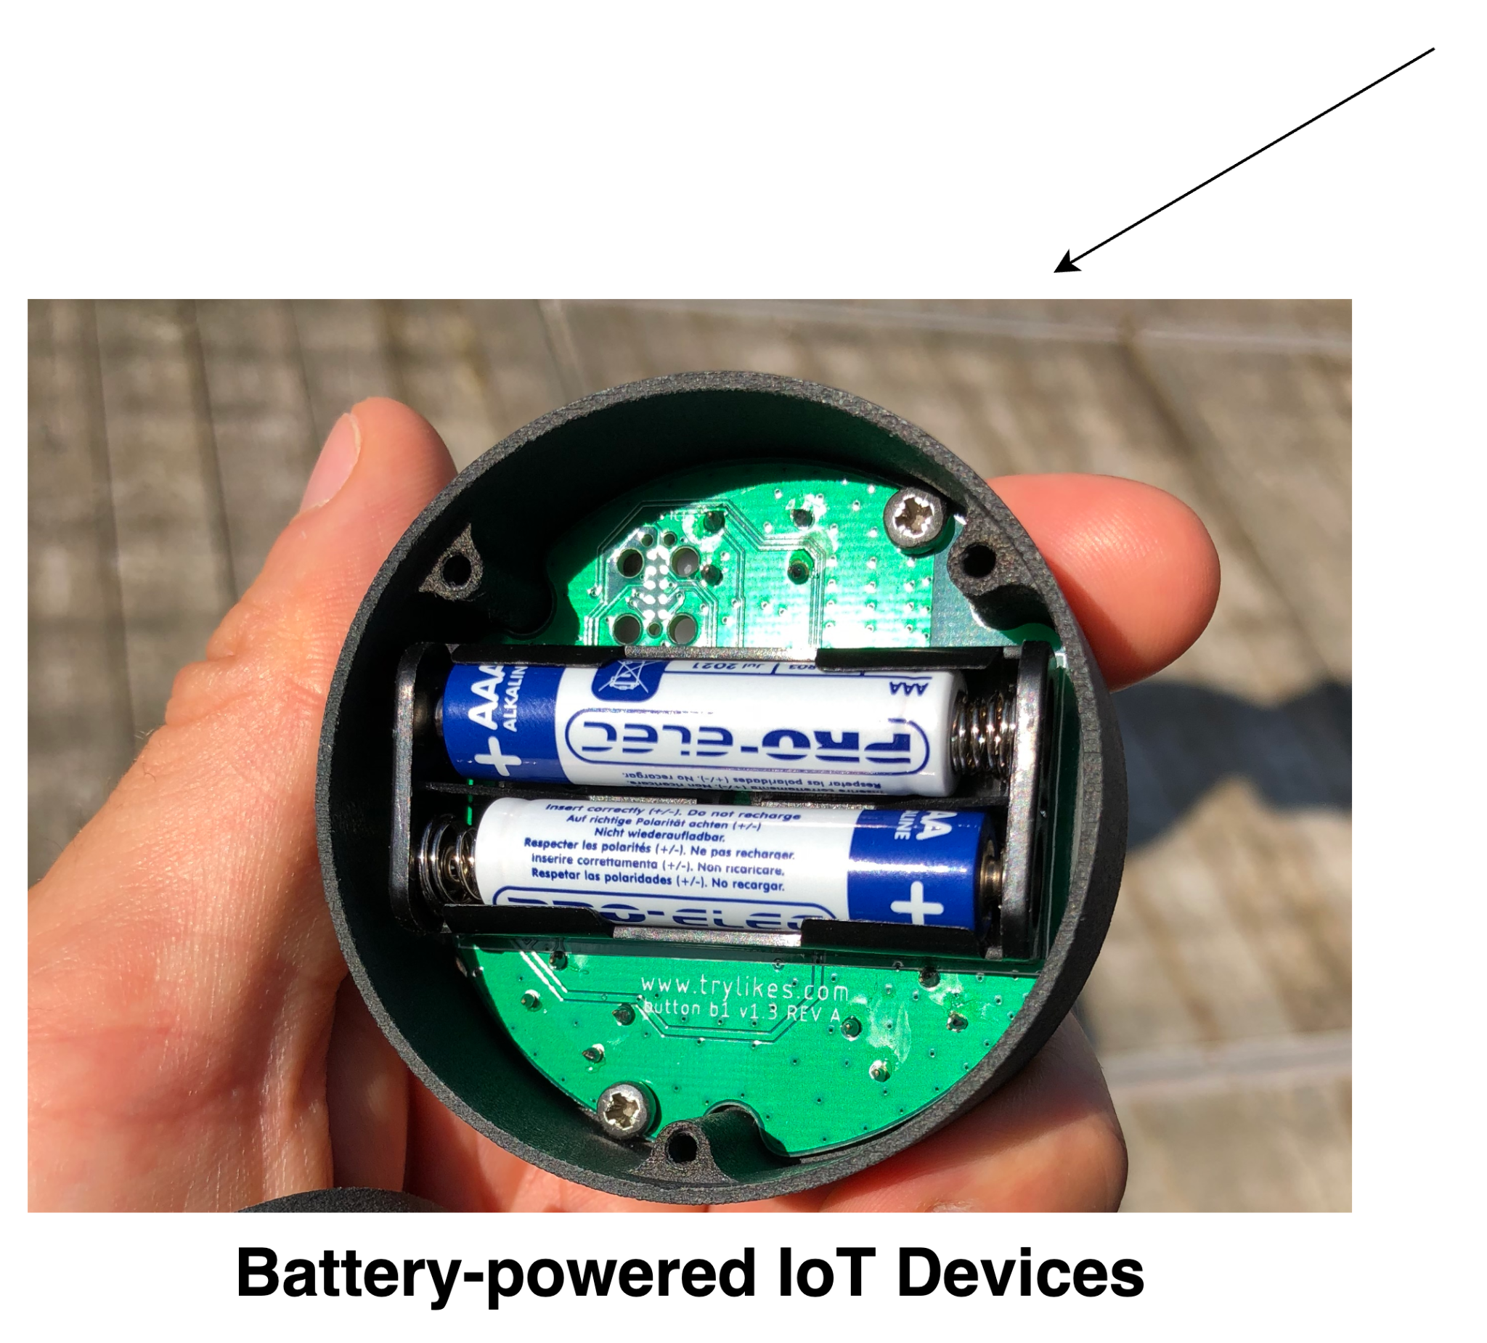
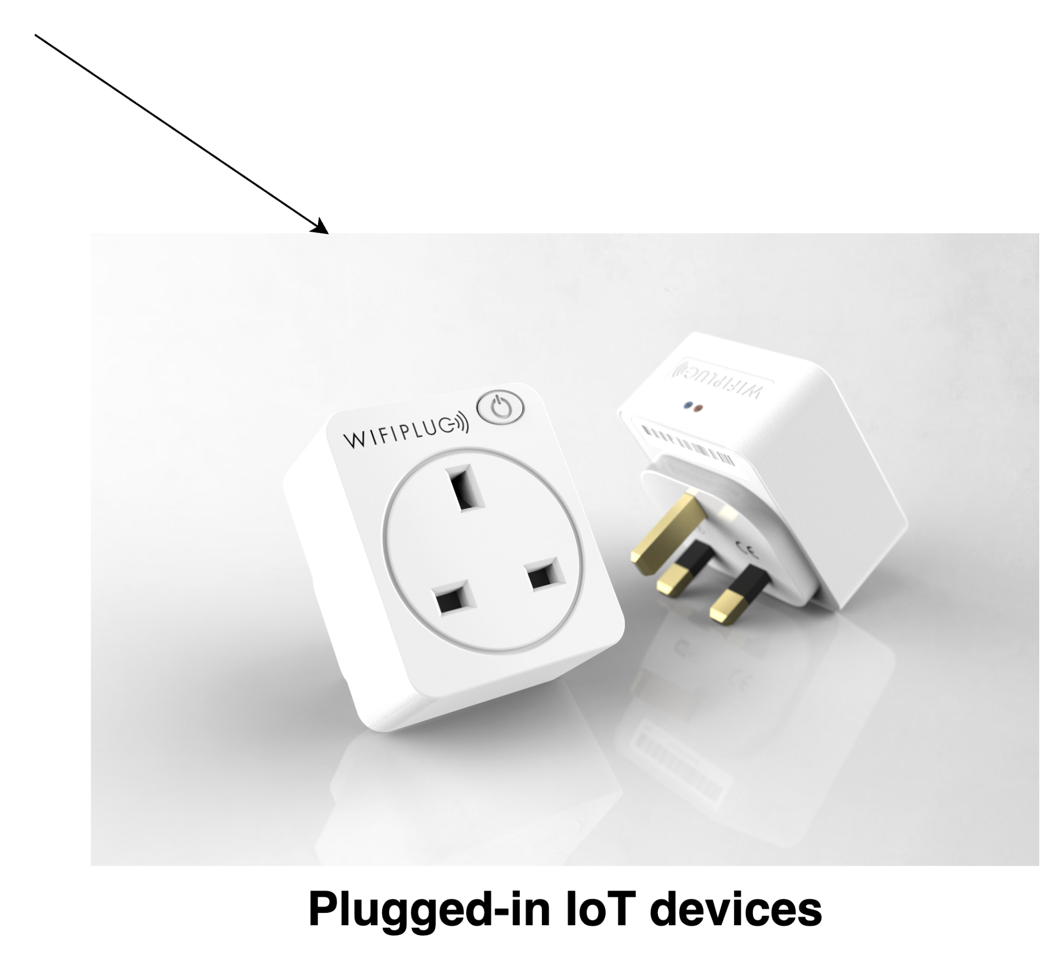
Power Supply
devices that rely on a battery (can be rechargeable) as their primary power source
devices that are connected directly to a power outlet for a continuous supply of power, without relying on batteries or other portable power sources

Slide 12
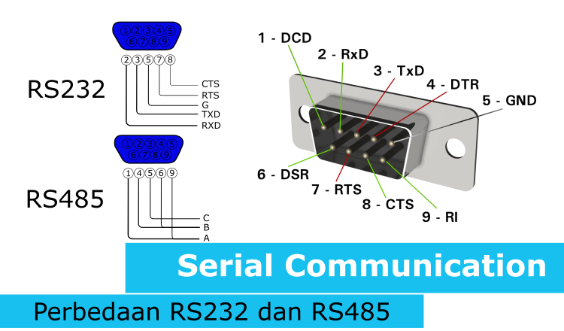
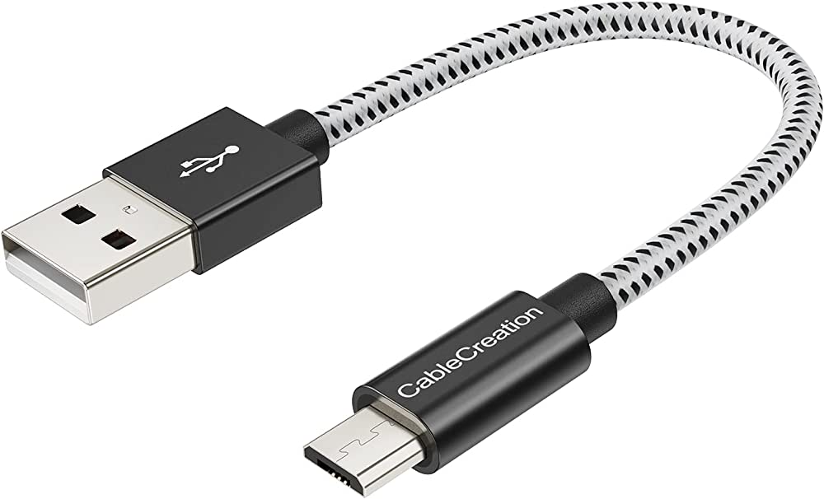
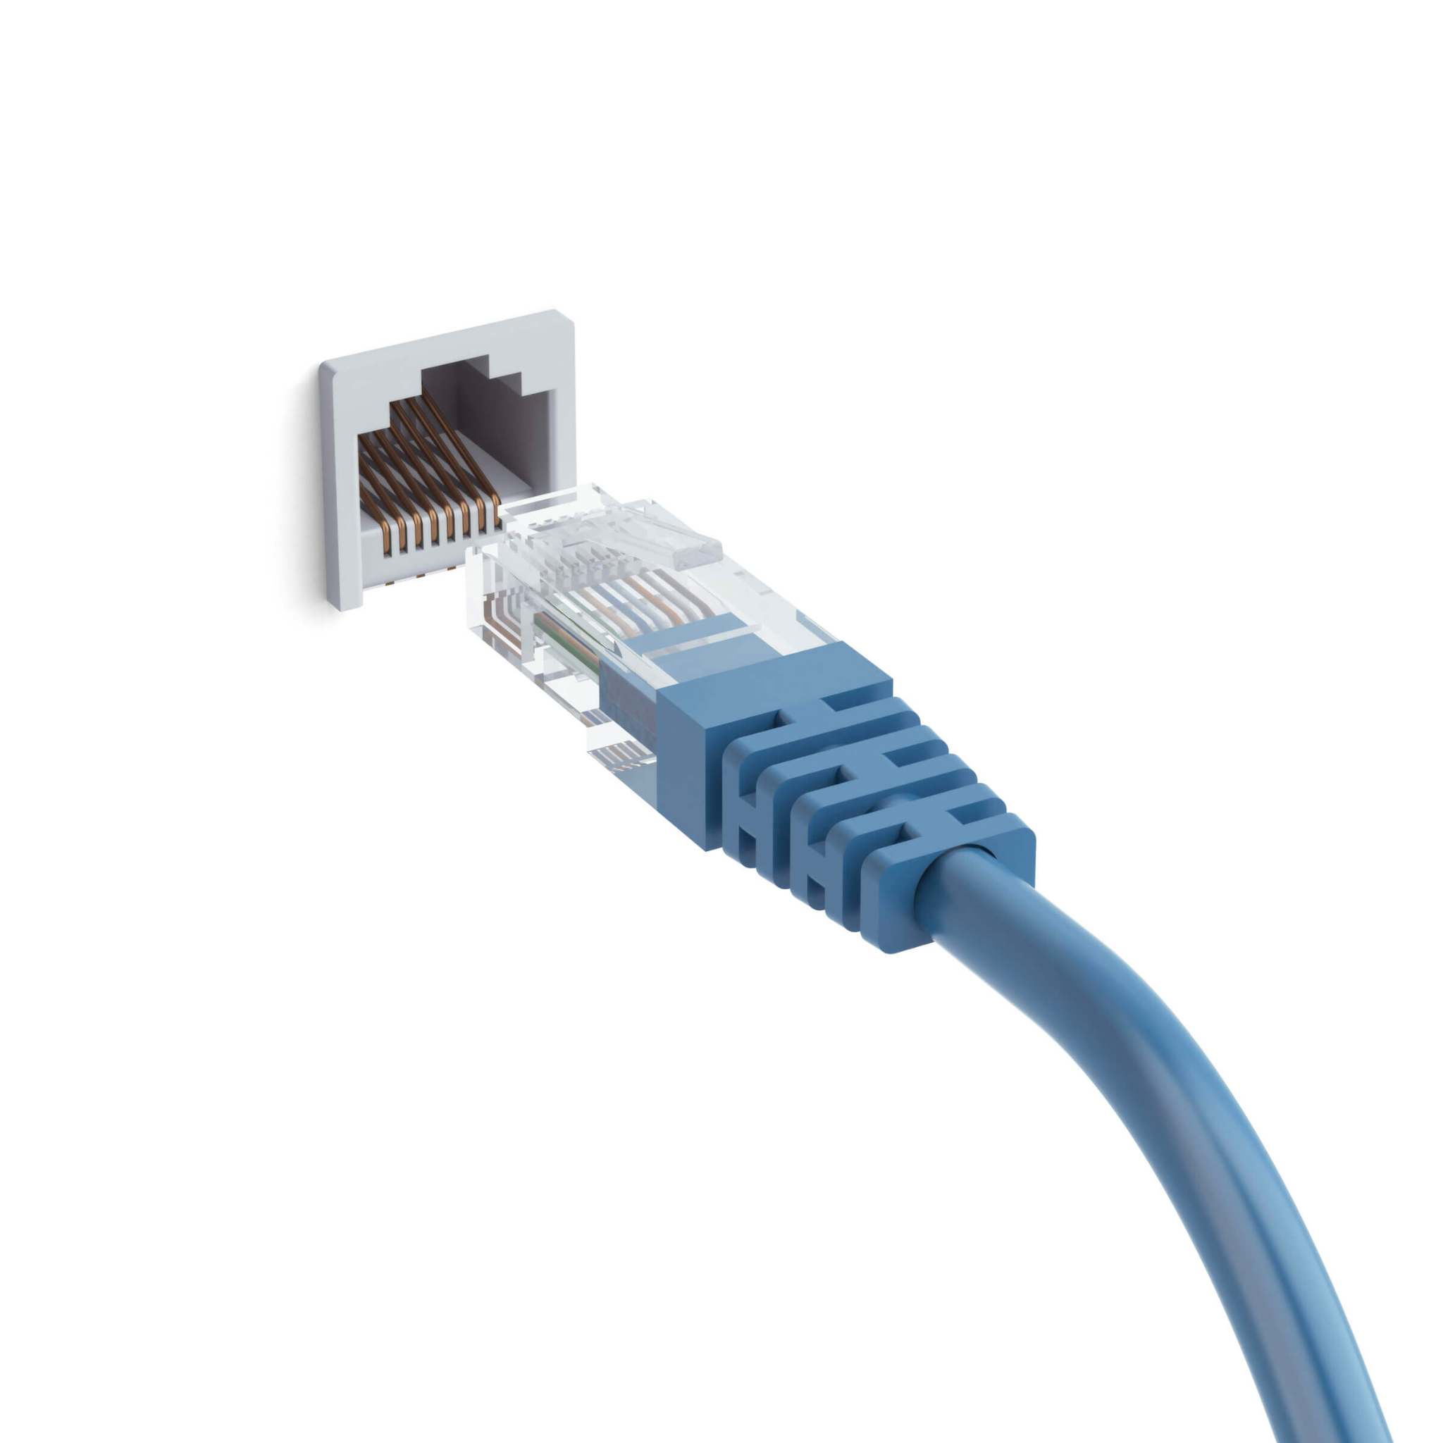

Connectivity (Wired)
Peripherals Connectivity:
GPIO - General Purpose Input/Output
SPI - Serial Peripheral Interface
UART - Universal Asynchronous Receiver/Transmitter
And Many Many others…
I2C - Inter-Integrated Circuit

Slide 13
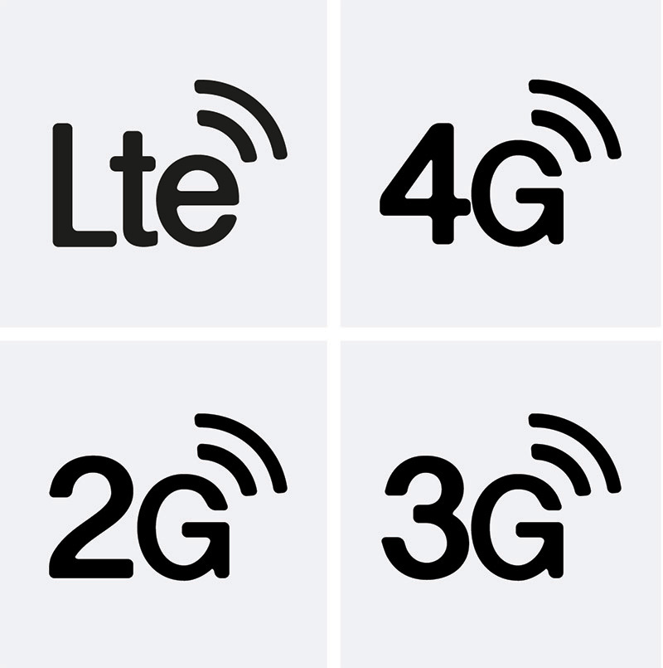





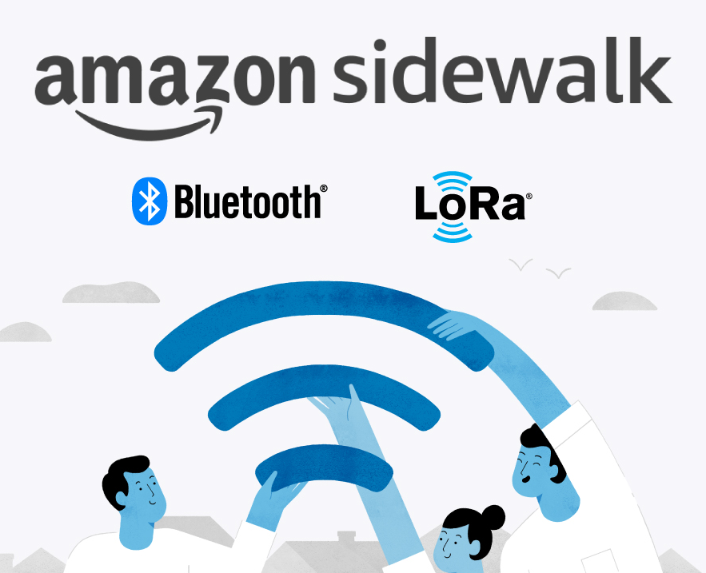


Connectivity (Wireless)
And Many Many others…

Slide 14
Examples of IoT Applications
SECTION #2

Slide 15

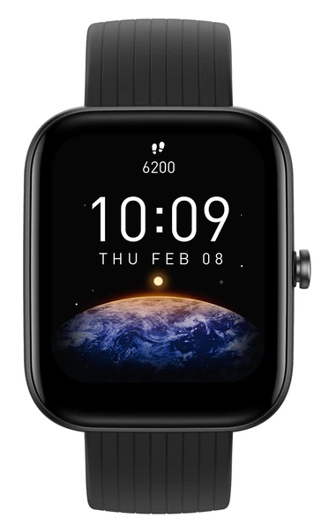
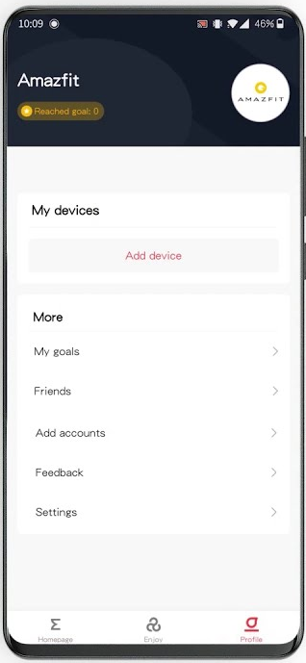
Smart Watch
Sensors: Accelerometer, Gyroscope, SpO2, GPS, Button, Touchscreen, etc.
Actuators: Touchscreen, Vibro
Controller: Microcontroller
Power Supply: Battery (up to 2w)
Connectivity: BLE
~10m

Slide 16
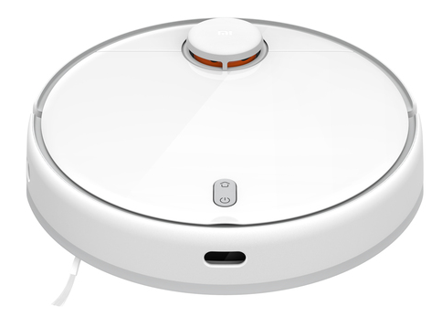
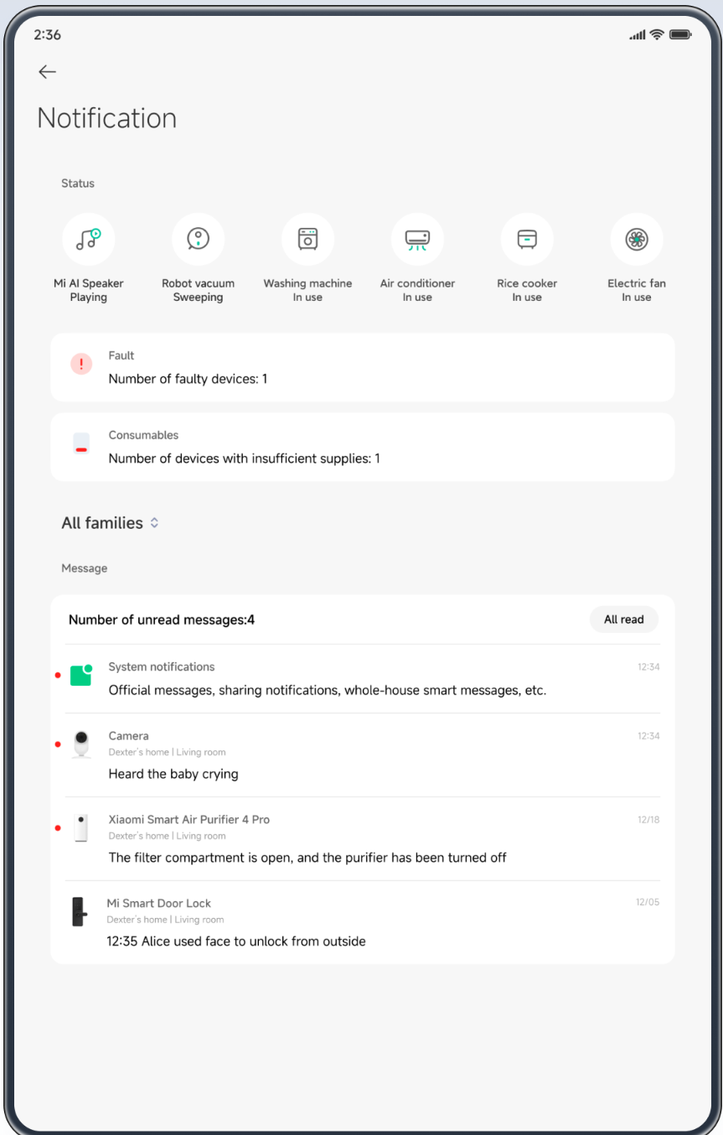
Robot Vacuum Cleaner
Sensors: Lidar, Infrared camera, Microphone, Gyroscope, Buttons, Bumper sensor, etc.
Actuators: Motors (wheels, brush, fan), Speaker, etc.
Controller: Microcomputer
Power Supply: Battery (up to 6h)
Connectivity: WiFi (primary), BLE (configuration)

Slide 17

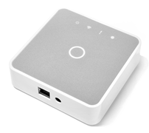
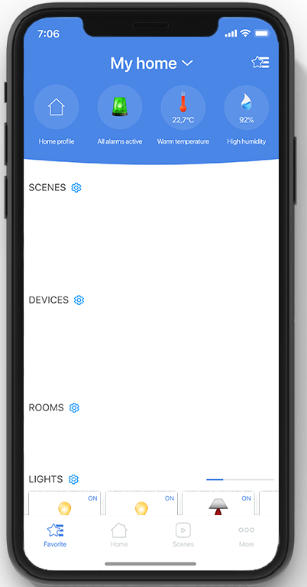
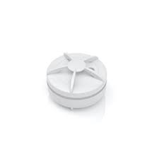
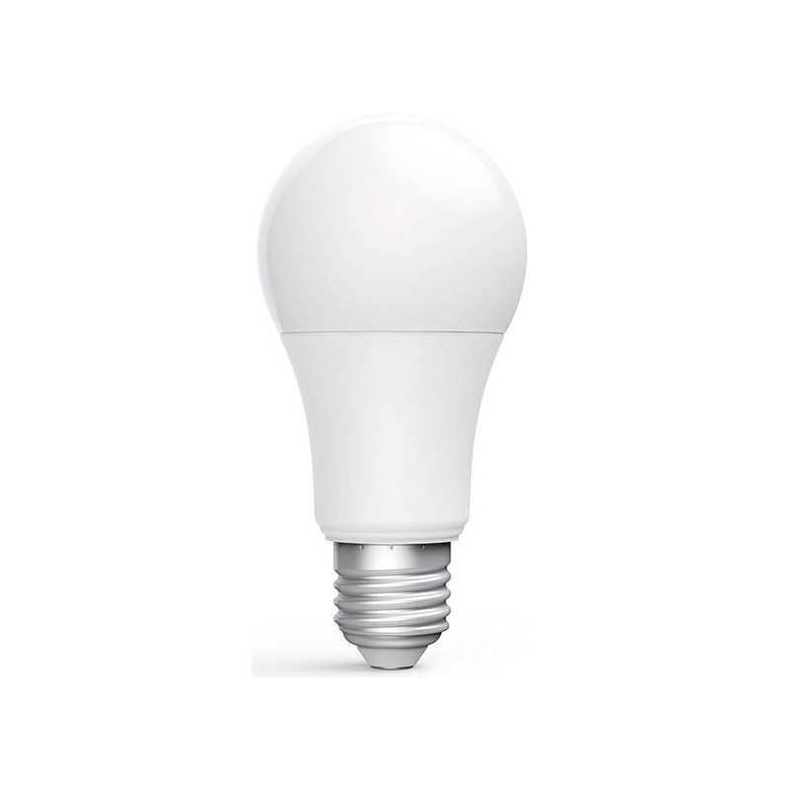
Smart Home / Building
Sensors: Humidity
Actuators: Speaker
Controller: Microcontroller
Power Supply: Battery (up to 2y)
Connectivity: Zigbee
Sensors: Light
Actuators: LED
Controller: Microcontroller
Power Supply: Plugged-in
Connectivity: Zigbee
Sensors: -
Actuators: -
Controller: Microcomputer
Power Supply: Plugged-in
Connectivity: Zigbee, WiFi
~15m
~15m
Water leak sensor
Smart Bulb
IoT Hub

Slide 18

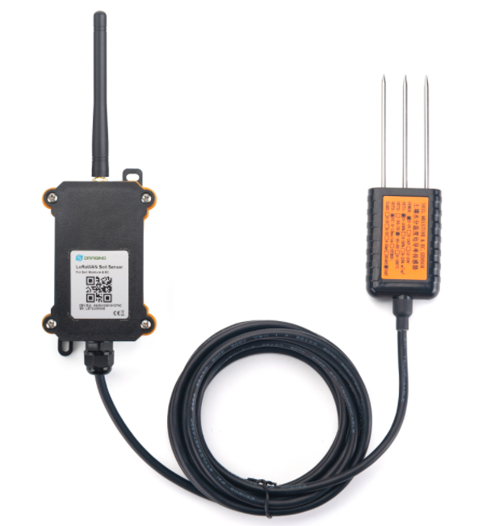
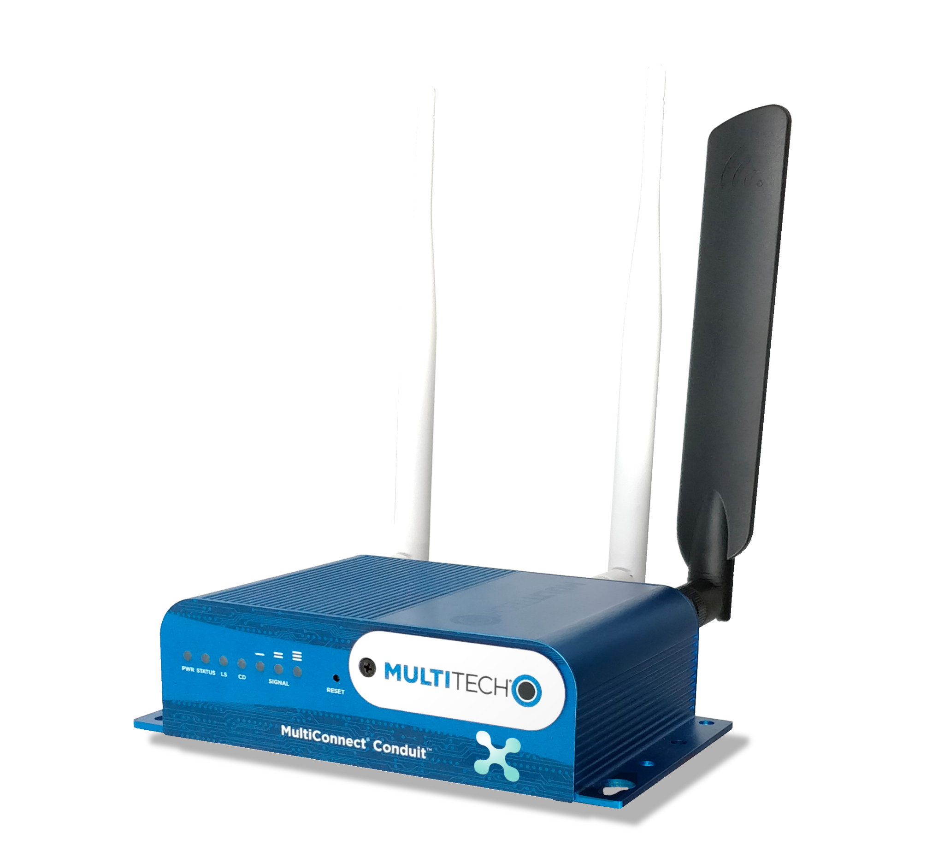
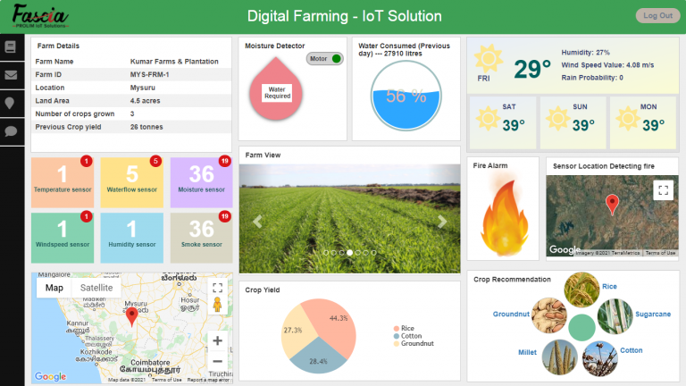
Smart Agriculture
Sensors: Soil Sensor, Temperature
Actuators: LED
Controller: Microcontroller
Power Supply: Battery (up to 10y)
Connectivity: LoRa
Sensors: -
Actuators: -
Controller: Microcomputer
Power Supply: Plugged-in
Connectivity: LoRa, WiFi, Eth, LTE, etc
~50km
Soil moisture sensor
LoRaWAN Gateway

Slide 19
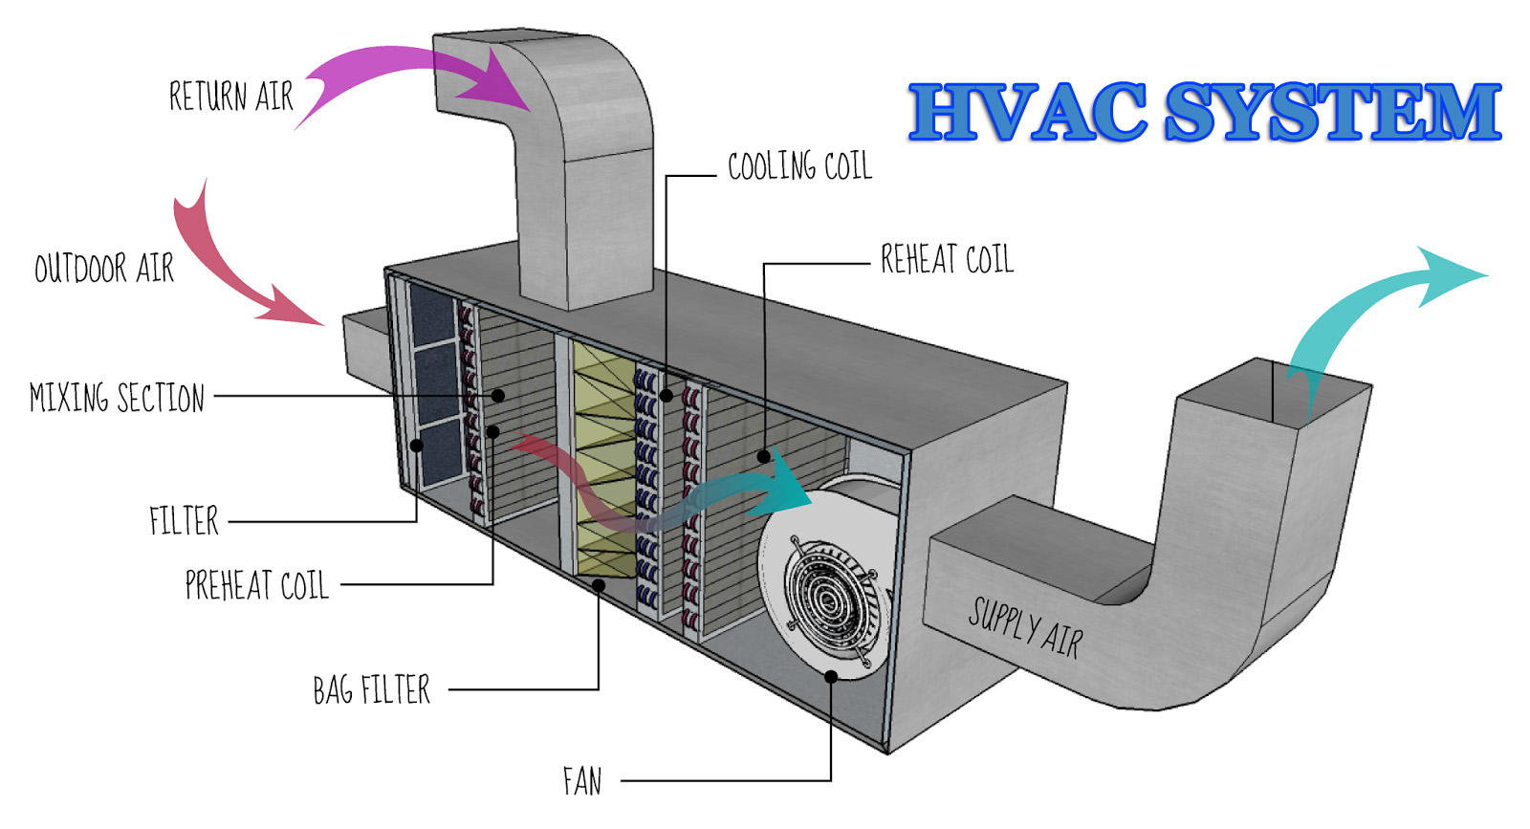

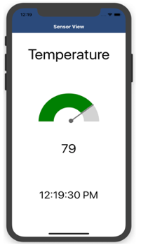
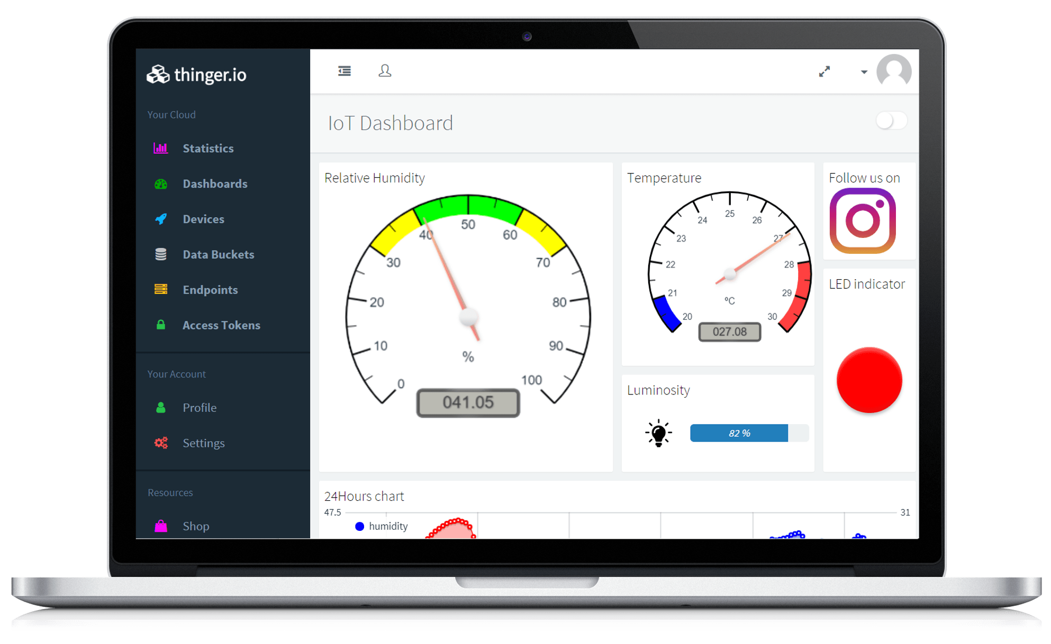
Industrial Asset Monitoring
Sensors: Temperature, CO2, Airflow, Pressure, etc.
Actuators: Fan, motors, etc.
Controller: PLC
Power Supply: Plugged-in
Connectivity: Modbus over RS485
Sensors: -
Actuators: -
Controller: Microcomputer
Power Supply: Plugged-in
Connectivity: Modbus over RS485, LTE/4G, etc.
Industrial IoT Gateway

Slide 20
Device and Cloud Communication
SECTION #3

Slide 21
Application Protocols for IoT
TCP
UDP
HTTP
Secure
Unsecure
COAP
Connection-Oriented
Connectionless
Socket
Slow
Fast
LWM2M
Guaranteed Transmission
No Guarantee
AMQP
Used by Critical Applications
Used by Real-Time Applications
Packet Reorder Mechanism
No Reorder Mechanism
MQTT-SN
MQTT
Flow Control
No Flow Control
Advanced Error Checking
Basic Error Checking (Checksum)
etc
etc
20 Bytes Header
8 Bytes Header
Acknowledgement Mechanism
No Acknowledgement
Three-Way Handshake
No Handshake Mechanism

Slide 22
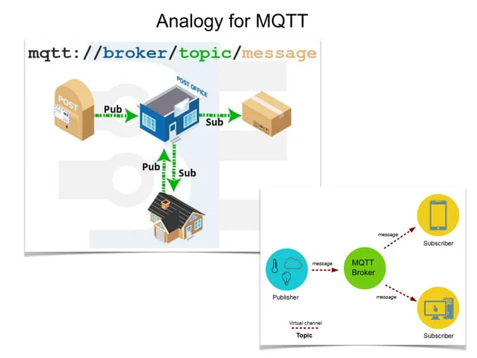

MQTT 101
Serverless MQTT Broker with extras

Slide 23
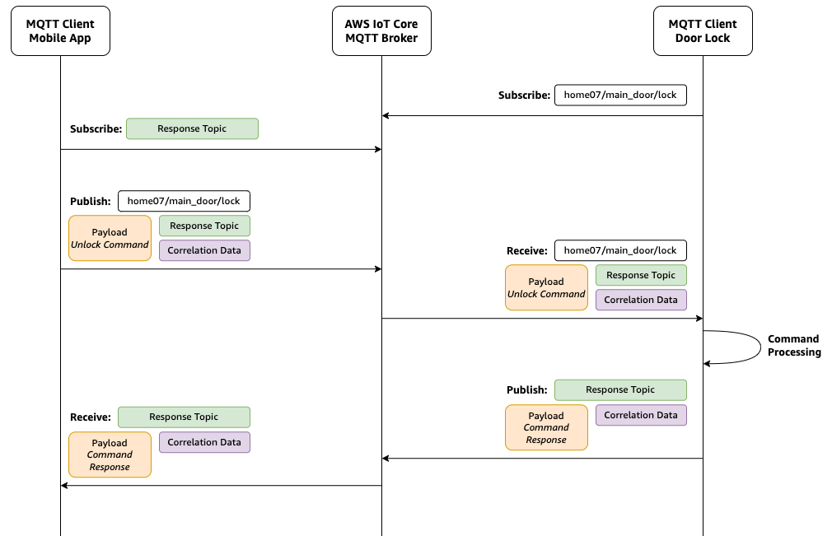
Request Response Pattern in MQTT
Typical use-case:
Execution of Commands on the Device from Cloud

Slide 24


Security in MQTT
MQTTs = MQTT + TLS

Slide 25
Coffee Break
15 minutes

Slide 26
AWS IoT Core DEMOs
SECTION #4

Slide 27


Demo Setup
AWS IoT Device SDK v2 for Python

Slide 28


AWS IoT Core Security

Slide 29

AWS IoT Device Shadow

Slide 30

AWS IoT Core Rules

Slide 31

AWS IoT Сore Jobs

Slide 32
AWS IoT Services Landscape and Future Plans
SECTION #5

Slide 33

AWS IoT Services Landscape
Open Questions:
How do x.509 certs appear on the device during manufacturing?
How to rotate certificates on the device?
How to perform firmware update on the device?
How to manage a fleet of the devices in the Cloud?
What I can do with device data in the Cloud?
etc…

Slide 34

Future Plans
We are thinking about running the following events:
A workshop on Amazon FreeRTOS
A workshop on AWS GreenGrass
A lecture on handling IoT device data in the Cloud
A workshop on Machine Learning with Greengrass
Please fill out a survey if you are interested in any of these IoT events

Slide 35
Thank You!
Q&A

Slide 36

Connect with me on LinkedIn
Github Repo with Samples
Meetup Feedback Form
Careers at Klika Tech
USEFUL LINKS
Notes:
Slide for PM/Developer/QA

